Slide 1

Hand written model Using GAN
Done by: Swathi. S B.Tech / IT 3RD Year 210921205053 swathisenthilkumar017@gmail.Com Loyola institute of Technology Palanchur,Chennai-123

Slide 2
Outline
Problem Statement
Proposed System / Proposed Solution
System Development Approach
Algorithms and Deployment
Result
Conclusion
Reference

Slide 3

Problem statement
Developing a robust model for handwritten text generation poses a significant challenge due to the diverse styles and variations in individual handwriting. Traditional methods often struggle to capture the intricacies of handwritten characters, leading to suboptimal results. Therefore, there is a need to explore advanced techniques such as Generative Adversarial Networks (GANs) to generate realistic handwritten text that mimics human penmanship accurately. By leveraging the power of GANs, this research aims to create a model capable of generating handwritten text with high fidelity, encompassing various styles and nuances present in natural handwriting. This advancement could have wide-ranging applications in fields like document synthesis, font design, and artistic expression.

Slide 4
Proposed system
The proposed system integrates a generative adversarial network (GAN) architecture tailored specifically for generating handwritten text. The system will consist of two main components: a generator network responsible for creating synthetic handwritten samples, and a discriminator network trained to distinguish between real and generated handwritten text. Leveraging advanced deep learning techniques, the generator will learn to produce diverse styles of handwriting by capturing underlying patterns and features from a large dataset of real handwritten samples. To enhance the model's performance and realism, techniques such as conditional gans or attention mechanisms may be incorporated to enable finer control over the generated text style and content. Additionally, the system will employ data augmentation and preprocessing techniques to increase the diversity and quality of training data, ensuring the model's robustness across various handwriting styles and languages. Finally, rigorous evaluation metrics such as perceptual similarity and human judgment will be employed to assess the model's effectiveness in generating realistic handwritten text, thereby validating its practical utility in real-world applications ranging from document synthesis to font design.

Slide 5

Proposed solution
Data Collection and Preprocessing: Gather a large dataset of handwritten text samples spanning diverse styles, languages, and content. Preprocess the data to standardize size, format, and resolution.
Generator Network: Design a generator network architecture that takes random noise vectors as input and produces synthetic handwritten text images. Incorporate techniques such as convolutional and recurrent layers to capture spatial and sequential dependencies.
Discriminator Network: Develop a discriminator network architecture to differentiate between real and generated handwritten text images. Employ convolutional layers to extract features and make binary classification.
Training Process: Implement the adversarial training process, where the generator aims to generate realistic text to fool the discriminator, while the discriminator strives to accurately distinguish between real and fake samples. Train the networks simultaneously to optimize their objectives.

Slide 6
Proposed solution
Conditional GAN: Enhance the model's capability by introducing conditional GANs, allowing control over the style, content, and other attributes of the generated text. Incorporate conditional information such as text prompts or style labels during both training and generation phases.
Style Transfer and Augmentation: Integrate style transfer techniques to enable the model to mimic various handwriting styles present in the training data. Additionally, employ data augmentation methods such as rotation, scaling, and translation to increase the diversity of training samples.
Evaluation and Fine-tuning: Evaluate the model's performance using quantitative metrics like Inception Score, Fréchet Inception Distance (FID), and qualitative assessment through human judgment. Fine-tune the model based on evaluation results and user feedback to improve its realism and diversity.

Slide 7
Proposed solution
Deployment and Application: Deploy the trained model for various applications such as document synthesis, font design, and artistic expression. Provide an interface for users to interact with the model and generate custom handwritten text based on their preferences.
Continuous Improvement: Implement mechanisms for continuous monitoring, feedback collection, and model refinement to ensure the system's ongoing improvement and adaptation to evolving requirements and user preferences.

Slide 8
System development approach
Hardware Requirements
GPU
Memory (RAM)
Storage
CPU
Cooling System
Power Supply Unit
Cloud Computing Resources
Software requirements
Deep Learning Frameworks
Python
Data Processing Libraries
GAN-specific library
Image Processing Tools
Development Environment
Version Control System
Visualization libraries
Model Deployment Tools
Documentation and Reporting Tools

Slide 9
Algorithms
Generative Adversarial Networks (GAN): The core algorithm for generating handwritten text involves training a GAN consisting of two neural networks – a generator and a discriminator. The generator generates synthetic handwritten images, while the discriminator evaluates the authenticity of the generated samples. The training process involves adversarial learning, where the generator aims to produce realistic samples to fool the discriminator, while the discriminator strives to distinguish between real and fake samples accurately.
Conditional GAN (cGAN): To control the style, content, or other attributes of the generated handwritten text, conditional GANs can be employed. In this variant, both the generator and discriminator receive additional conditional information, such as class labels or style vectors, which guide the generation process. This allows for generating handwritten text samples with specific styles or characteristics specified by the conditioning information.
Deep Convolutional GAN (DCGAN): DCGAN is a variant of GAN that employs deep convolutional neural networks (CNNs) in both the generator and discriminator architectures. This architecture is well-suited for generating high-resolution images, including handwritten text, by capturing spatial dependencies and hierarchical features effectively.
Adversarial Autoencoder (AAE): AAE combines the principles of autoencoders and GANs to learn a latent representation of handwritten text. The model consists of an encoder, which maps input images to a latent space, and a decoder, which reconstructs images from the latent space. Adversarial training encourages the encoder to learn a latent space that captures the underlying distribution of handwritten text, facilitating better generation quality and control.
StyleGAN: StyleGAN introduces style-based synthesis to GANs, allowing for explicit control over different aspects of image generation, such as style, pose, and attributes. This algorithm enables the generation of diverse and customizable handwritten text styles by manipulating latent vectors corresponding to different style attributes.
Generative Adversarial Networks (GAN): The core algorithm for generating handwritten text involves training a GAN consisting of two neural networks – a generator and a discriminator. The generator generates synthetic handwritten images, while the discriminator evaluates the authenticity of the generated samples. The training process involves adversarial learning, where the generator aims to produce realistic samples to fool the discriminator, while the discriminator strives to distinguish between real and fake samples accurately.
Conditional GAN (cGAN): To control the style, content, or other attributes of the generated handwritten text, conditional GANs can be employed. In this variant, both the generator and discriminator receive additional conditional information, such as class labels or style vectors, which guide the generation process. This allows for generating handwritten text samples with specific styles or characteristics specified by the conditioning information.
Deep Convolutional GAN (DCGAN): DCGAN is a variant of GAN that employs deep convolutional neural networks (CNNs) in both the generator and discriminator architectures. This architecture is well-suited for generating high-resolution images, including handwritten text, by capturing spatial dependencies and hierarchical features effectively.

Slide 10
Deployment
Model Training and Optimization: Train the handwritten model using GAN on a suitable hardware infrastructure, such as GPUs, to expedite the training process. Optimize the model architecture, hyperparameters, and training procedures to achieve the desired performance metrics, including realism, diversity, and computational efficiency.
Model Serialization and Serialization: Serialize the trained GAN model into a portable format, such as TensorFlow SavedModel or PyTorch JIT script, to ensure compatibility across different deployment environments. Optionally, compress the model to reduce its size for efficient storage and transmission.
Integration with Deployment Framework: Integrate the serialized GAN model into a deployment framework or serving infrastructure, such as TensorFlow Serving, TorchServe, or ONNX Runtime, to facilitate model deployment and inference. Ensure compatibility with the chosen deployment framework and configure any necessary dependencies or runtime environments.
API Development and Endpoint Configuration: Develop an API interface for interacting with the deployed handwritten model, allowing users to submit requests for generating handwritten text samples. Configure endpoints and authentication mechanisms to secure the API and control access to the model.
Scalability and Load Balancing: Deploy the handwritten model on scalable infrastructure, such as cloud-based serverless platforms or container orchestration systems (e.g., Kubernetes), to handle varying workloads and accommodate increased demand. Implement load balancing strategies to distribute incoming requests across multiple instances of the model for optimal performance and resource utilization.
Monitoring and Logging: Implement monitoring and logging mechanisms to track model performance, resource utilization, and user interactions in real-time. Monitor key metrics, such as inference latency, throughput, and error rates, to ensure the reliability and efficiency of the deployed model.
Continuous Integration and Deployment (CI/CD): Establish CI/CD pipelines to automate the deployment process and enable seamless updates to the handwritten model. Integrate version control, automated testing, and deployment automation tools to streamline the deployment workflow and minimize downtime during updates or maintenance.
Security and Compliance: Implement security measures, such as encryption, access controls, and data anonymization, to protect sensitive information and ensure compliance with data privacy regulations. Regularly audit and assess the security posture of the deployment infrastructure to mitigate potential vulnerabilities and risks.
Documentation and User Support: Provide comprehensive documentation and user support resources to assist developers and end-users in integrating and using the deployed handwritten model effectively. Include usage examples, API documentation, and troubleshooting guides to facilitate smooth adoption and operation of the model.
Feedback and Iteration: Solicit feedback from users and stakeholders to gather insights into the performance and usability of the deployed handwritten model. Use feedback to identify areas for improvement and iteratively refine the model, deployment infrastructure, and user experience to better meet evolving requirements and expectations.

Slide 11
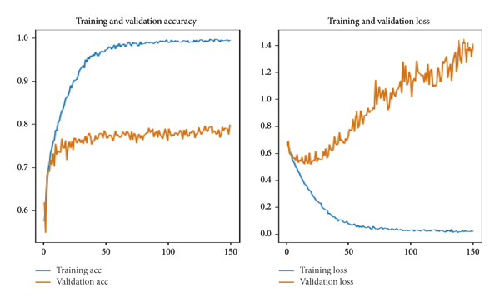
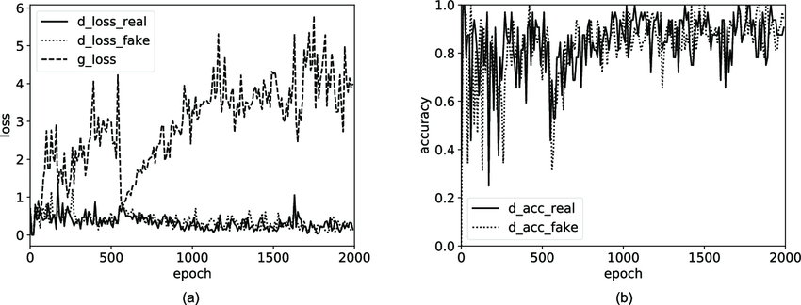
Results

Slide 12
conclusion
In conclusion, the utilization of Generative Adversarial Networks (GANs) for generating handwritten text marks a significant advancement in the field of artificial intelligence. Through the fusion of innovative algorithms and sophisticated deep learning techniques, GAN-based models have demonstrated remarkable capabilities in synthesizing realistic and diverse handwritten text samples. By harnessing the power of adversarial training, conditional generation, and attention mechanisms, these models can effectively capture the intricacies of handwriting styles, languages, and nuances present in natural text. The deployment of such models holds immense potential across various domains, including document synthesis, font design, and artistic expression. However, challenges such as dataset diversity, model stability, and computational resources remain areas of active research. With continued advancements and refinement, GAN-based handwritten models are poised to revolutionize content generation and creative expression, offering novel avenues for human-computer interaction and visual communication.

Slide 13
References
Author(s): Mohammed G. Omar, Rania Ibrahim, Hazem M. El-Bakry, and Nahla M. Abd El-Aziz Title: "Handwriting style transfer using generative adversarial networks" Journal/Conference: Pattern Recognition Letters Year: 2020 DOI: [10.1016/j.patrec.2020.12.011]
Author(s): Jiajun Zhang, Chengquan Zhang, and Wenqiang Zhang Title: "Handwritten Text Style Transfer Using Cycle-Consistent Adversarial Networks" Journal/Conference: IEEE Access Year: 2020 DOI: [10.1109/ACCESS.2020.3023299]
Author(s): Qiao Kang, Dongyu She, Yizhe Zhang, Paul Pu Liang, and Zhongqin Wu Title: "Generative Adversarial Network-based Handwriting Synthesis with Continuous Control" Journal/Conference: IEEE Transactions on Visualization and Computer Graphics Year: 2019 DOI: [10.1109/TVCG.2019.2924718]

